Slide 1
HySquant: Post Training Quantization Policy Search for Hybrid Model
Shaibal Saha
Yunge Li
Notes:
Today we will present our project...

Slide 2
Agenda
Introduction
Related works
Objective
Framework
Sensitivity analysis
Time line
Conclusion & Future work
Notes:
This is the content we will show today

Slide 3
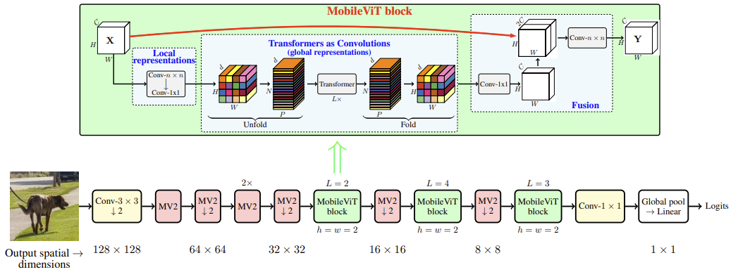
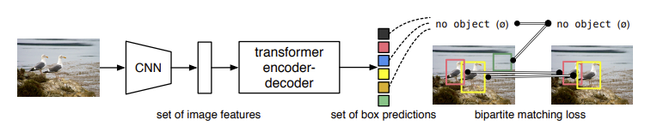
Introduction
In the field of deep learning, CNN and Transformer models have shown significant advantages in image feature extraction and global dependency modeling respectively. In recent years, hybrid models combining CNN and Transformer have become a mainstream trend.
MobileViT
DETR
Diversity in quantization requirements.
PTQ (Post-Training Quantization) provides a lighter solution for large-scale hybrid models.
Mehta, Sachin, and Mohammad Rastegari. "Mobilevit: light-weight, general-purpose, and mobile-friendly vision transformer." arXiv preprint arXiv:2110.02178 (2021).
Carion, Nicolas, et al. "End-to-end object detection with transformers." European conference on computer vision. Cham: Springer International Publishing, 2020.
Notes:
Ok. In the field of deep learning, CNN and Transformer models have shown significant advantages in image feature extraction and global dependency modeling respectively. In recent years, Hybrid models that combine CNN and Transformer have become a mainstream trend, such as mobileViT and DETR below, which integrate local feature extraction and global context capture to achieve excellent performance in computer vision tasks.
This hybrid model leads to the diversity of quantization requirements. Because the CNN layer pays more attention to weight quantization, while the Transformer layer is more sensitive to the quantization of activation values ​​and Softmax, it is difficult to unify the quantization strategy of the hybrid model.
In addition, since the computation of hybrid model is more complicated, PTQ is a better choice than QAT because it does not require retraining the model. Therefore, our work this time is also focus on PTQ policy.

Slide 4
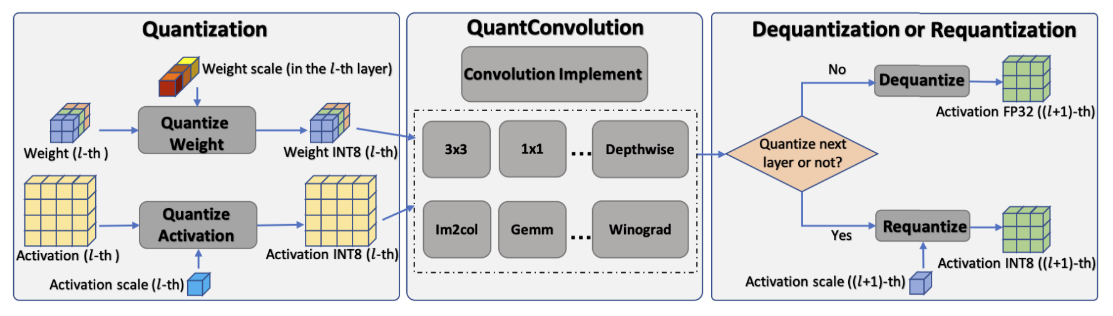
Related Works
EasyQuant
1
2
3
Pro:
Simple and efficient: Only a small amount of calibration data is needed, no model fine-tuning is required
Hardware friendly: Designed for INT8 computations, compatible with most modern hardware.
Efficient inference: Optimize computing efficiency through hierarchical quantization, especially good for edge devices.
Con:
For complex models such as Transformers, it can not avoid performance degradation.
Only INT8 quantization is supported.
Wu, D., Tang, Q., Zhao, Y., Zhang, M., Fu, Y., & Zhang, D. (2020). EasyQuant: Post-training Quantization via Scale Optimization. arXiv preprint arXiv:2006.16669.
Notes:
Next, I will introduce some typical PTQ work and quantization policy search work.
The first is easyquant. Easyquant is a very typical PTQ work for CNN models. EasyQuant has three stages.
First, in the quantization stage, weights and activations are quantized in each layer. Then the second stage uses the optimized convolution implementation to directly process the quantized INT8 data. Finally, between layers, if it is necessary to enter the quantization calculation of the next layer, requantization will be performed; if it is output or other requirements, it will be dequantized to floating point numbers to maintain flexibility.
Therefore, we can see that EasyQuant is very simple and efficient, and it is also very hardware-friendly because most edge devices support INT8. However, EasyQuant cannot support transformer-based model. And it supports quantization to INT8 but cannot be converted to other data types.

Slide 5
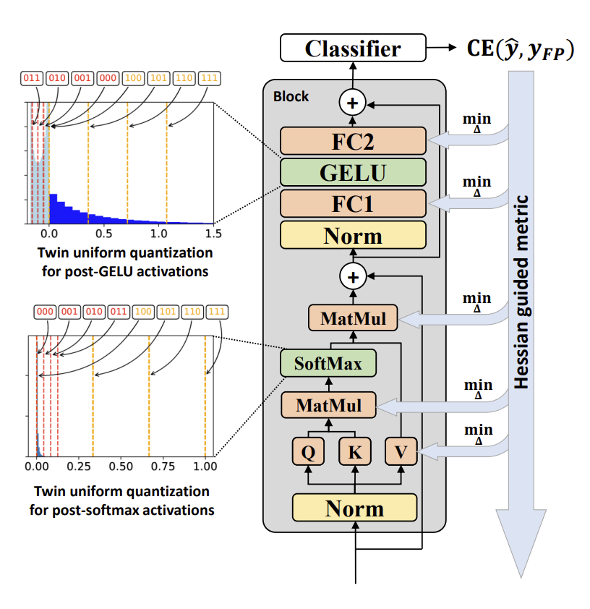
Related Works
PTQ4ViT
Pro:
Specially optimize GELU and Softmax, adapt to Transformer model, and minimize accuracy loss.
Hessian-guided sensitivity analysis accurately selects quantization parameters and improves quantization results.
Con:
The computation in the quantitative calibration phase are complex and require a certain amount of calibration data.
It is not suitable for models using other activation functions such as ReLu and SiLu.
Yunqing Zhao, et al. "Post-Training Quantization for Vision Transformers with Twin Uniform Quantization." arXiv preprint arXiv:2111.12293 (2021).
Notes:
Then there is a PTQ work on VIT. As its name shows, it is called PTQ4VIT. In this work, they used Twin Uniform Quantization. This method is used to reduce the quantization error for the specific distribution after GELU activation and Softmax. In addition, they also introduced the Hessian-guided metric to measure the sensitivity of quantization to each layer, so as to select the quantization factor that minimizes performance loss to ensure high-precision model inference.
In this work, they optimized the quantization of transformer models such as ViT to ensure accuracy and efficiency. However, these two optimizations have increased the requirements for calibration data. In addition, their method cannot be extended to other models using other activation functions such as GELU or SiLu.

Slide 6
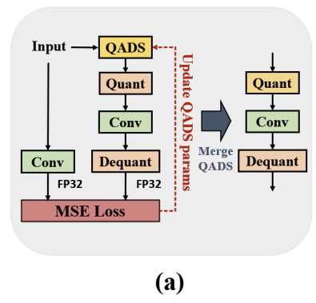
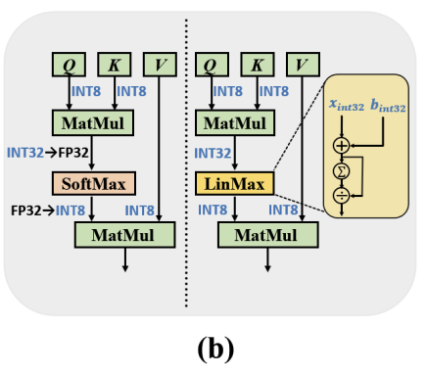
Related Works
HyQ
CNN part:
HyQ uses QADS (Quantization-Aware DeQuantization Strategy) to further reduce quantization error.
The optimization focuses on the low dynamic range error of convolution, and MSE Loss is used to calibrate the results of INT8 and FP32.
Transformer part:
HyQ proposed Linear Softmax (LinMax) as an alternative to simplify the calculation and reduce the complexity of hardware implementation.
Pro:
Adapting to hybrid architecture
Hardware friendly
Con:
The optimization synergy between modules is weak.
Strong assumptions about activation functions and architectural features.
Kim, Nam Joon, Jongho Lee, and Hyun Kim. "HyQ: Hardware-Friendly Post-Training Quantization for CNN-Transformer Hybrid Networks." IJCAI. 2024.
Notes:
The third work is HyQ. It aims to provide a hardware-friendly quantization solution for hybrid models combining CNN and Transformer. For the convolution part, the convolution layer is usually used as a feature extraction module in the Hybrid model, and its quantization is relatively mature. HyQ uses QADS (Quantization-Aware DeQuantization Strategy) to further reduce the quantization error. For the transformer part, HyQ proposes linear Softmax (LinMax) as an alternative to simplify the calculation and reduce the complexity of hardware implementation.
Therefore, HyQ is suitable for hybrid model, and it quantizes the model into INT8, so it is hardware-friendly.
However, HyQ optimizes the quantization parameters for the two parts separately in the hybrid architecture, but lacks a unified global optimization solution, which may introduce additional errors. In addition, it has strong assumptions on activation functions and architectural features. For example, QADS may be very effective for GELU functions, but if it is other activation functions, additional adjustments to the model architecture may be required.

Slide 7
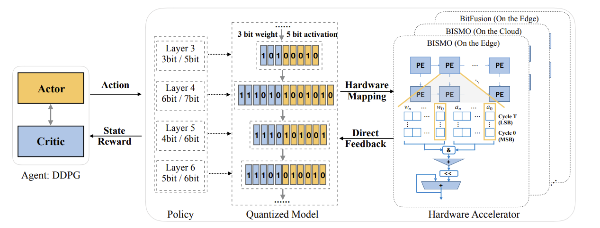
Related Works
HAQ
Pro:
Hardware-aware optimization: HAQ quantization strategy is highly matched to the target hardware characteristics, which can maximize hardware execution efficiency (such as throughput and latency optimization).
Layer-by-layer optimization and flexible adaptation: The quantization strategy of each layer is dynamically adjusted according to the sensitivity of the model.
Con:
Hardware dependency: HAQ optimization is heavily dependent on hardware feedback. Different hardware platforms require retraining of agents to adapt to their features, which results in insufficient versatility.
Wang, Kuan, et al. "Haq: Hardware-aware automated quantization with mixed precision." Proceedings of the IEEE/CVF conference on computer vision and pattern recognition. 2019.
Notes:
The previous work is all about PTQ. HAQ is an efficient hardware-aware quantization framework that automatically generates mixed-precision quantization strategies through reinforcement learning to improve the balance between hardware efficiency and model performance. In this framework, the quantization bit width of each layer of the model is dynamically determined by the RL agent to generate a set of mixed-precision quantization strategies. For example: the third layer uses 3-bit weights and 5-bit activations, and the fourth layer uses 6-bit weights and 7-bit activations. The quantized model is mapped to a hardware accelerator (such as BISMO or BitFusion) to run, directly feeding back the performance indicators (such as latency, energy consumption) of the hardware execution.
The RL agent continuously updates the strategy based on hardware feedback to optimize the trade-off between performance and efficiency. So, HAQ can generate quantization strategies for specific hardware characteristics, and it is flexible for the quantization of each layer. However, this also limits its versatility on hardware.

Slide 8

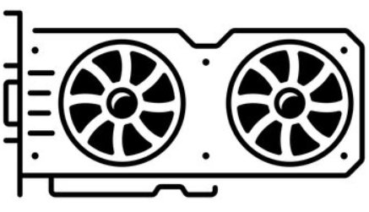
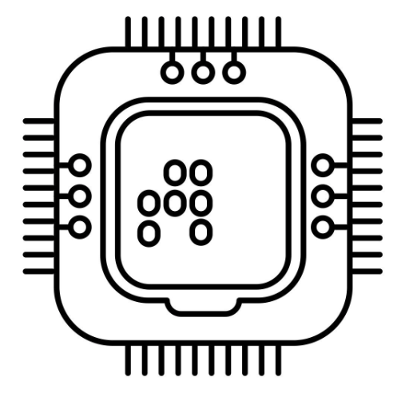
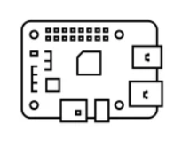
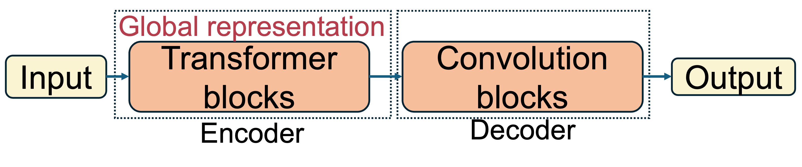
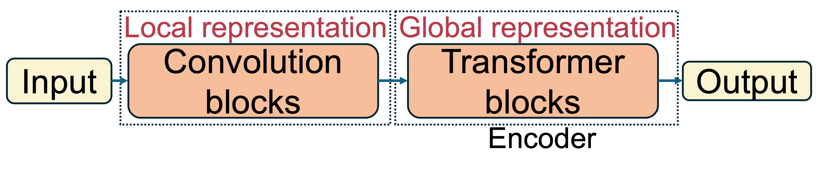
Objective
Hardware versatility
Flexibly adapts to the hybrid model
.…..
Notes:
Through the above introduction, we know that these typical works have their own advantages and disadvantages. EasyQuant is not suitable for transformers, and PTQ4VIT is not suitable for CNNs. HyQ is not very versatile, and HAQ has very strict hardware requirements.
Therefore, we want to propose a framework for automatically generating PTQ quantization strategies, which will have better hardware versatility, that is, the quantized model can be deployed on most hardware platforms. It is targeted at hybrid models, and it will be more flexible, regardless of whether the architecture of the hybrid model is CNN first and then Transformer or transformer first and then CNN.
Next….

Slide 9
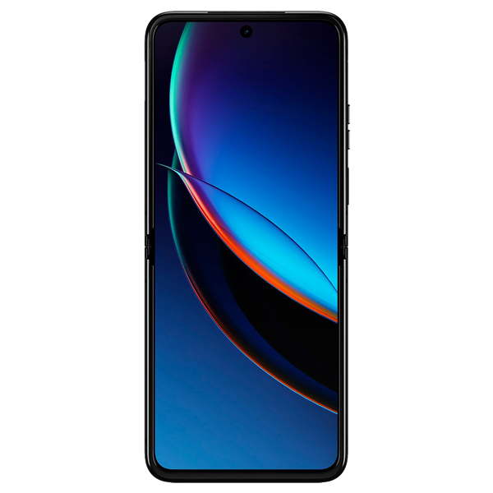
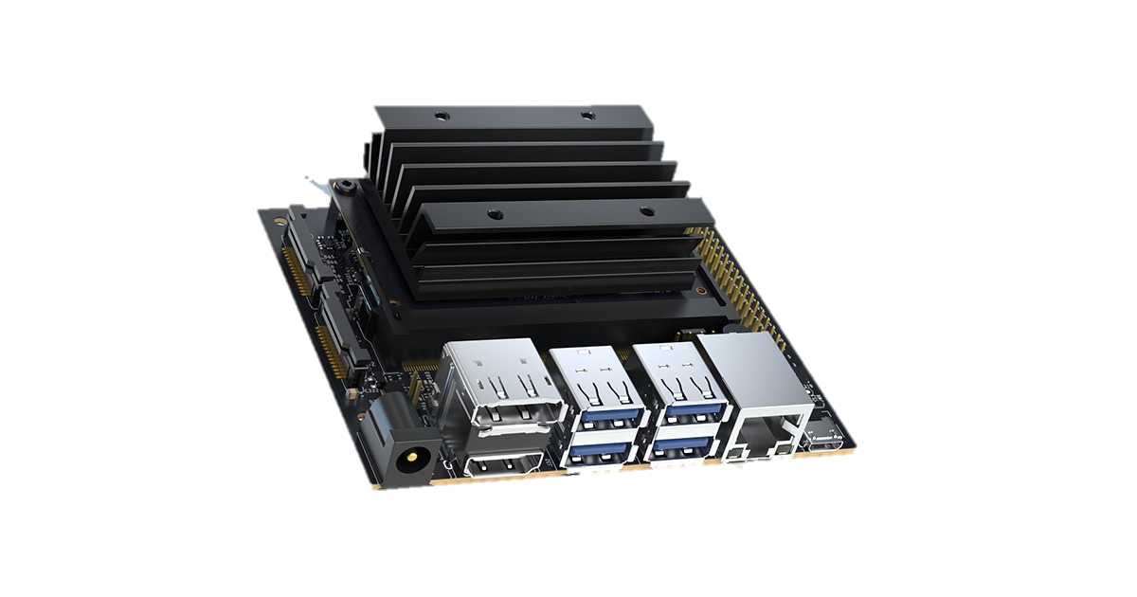
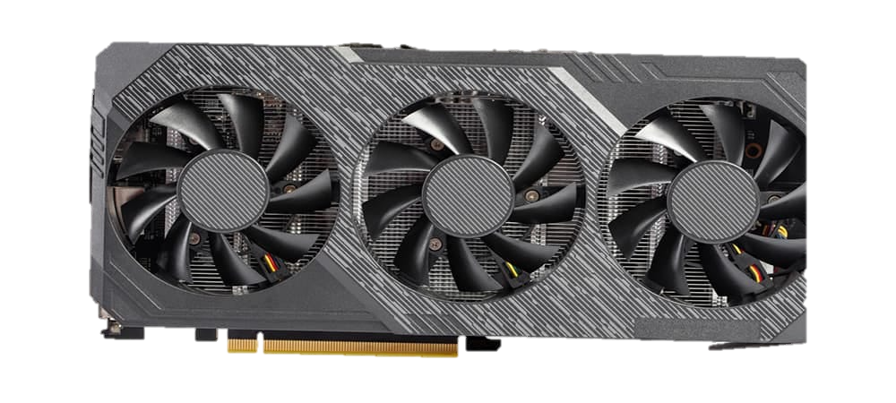
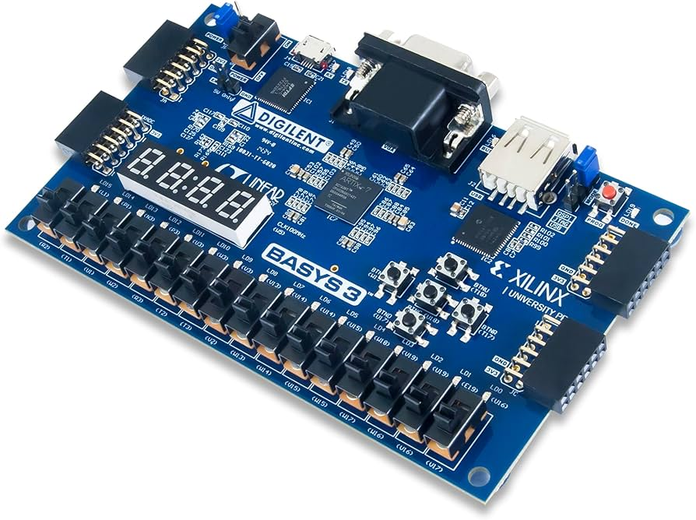
Framework
Measurement
Sensitivity Analysis
 | W-bit | A-bit | Accuracy | Latency | Energy
layer1
…… | ….. |  | ….. | ….. | …..
layer2
layer3
Pretrained model
Uniform Quantization
Search Engine
Weight/Activation Bit-width
Layer1
1
1
0
1
1
0
1
0
1
1
0
1
Layer2
1
Hardware devices
0
1
0
1
1
0
0
Layer3
1
1
1
0
1
Budget
:
Accuracy
Latency
Energy
….
Feedback
:
Accuracy
Latency
Energy
….
0
1
0
0
1
0
1
…
Quantized
Model
Meet 😊
…..
Quantization Policy
Evaluate
Not meet 😟
Notes:
Hello, I am Shaibal Saha. I will discuss about the proposed framework, How we do the sensitive analysis, and the pending timeline in details. As our main concern to finding the quantization policy specially for post training quantization based on the hardware requirement. We use pretrained hybrid models. Currently we are working with mobilevit models basically one of the hybrid models for classification task.
Click
We need two analysis or look up table for efficiently find the mixed precision layer by layer weight and activation quantization. For now, we only consider uniform/linear quantization as a quantization techniques. Later on we also consider log quantization because several studies already establish that log quantization is worked better if your weight/activation distribution is followed power-law distribution. For the scaling and zero point calculation, we currently only use min-max calculation. Then we apply uniform quantization for each layer for different bit-width (4/8). Document the top-1 and top-5 candidate for with only applying that particular layer. Additionally, for sensitive analysis, HySquant, document the latency and the energy consumed for this layer.
click
When we have the look up table of this sensitive analysis, we pass it to a search engine. For the time limitation, we don’t implement our search engine yet. However, we will use evolutionary search to find the quantization policy. clcik The reason behind its complexity and easy to search (notes: we are also considering RL but as we don’t do the preliminary study so we will still looking to fix this part).
click
After getting the quantization policy, we will deploy it to edge device (Nano, Xavier or FPGA). The model in this stage will be look like weight/activation bitwidths. We will take the feedback from the hardware (acc, latency and energy).
Click
The feeback results may have two senarios: Firstly, it can meet the hardware budgets which we can easily get from the description of the hardware. We will matchup this budget with the feedback. If it meets then we will save this as quantized model and if not we will get back to search engine to find the new combination.

Slide 10
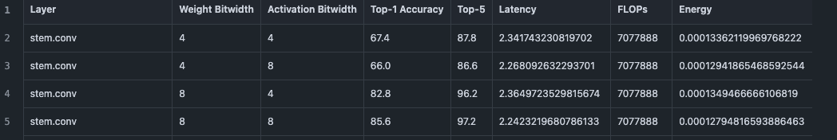
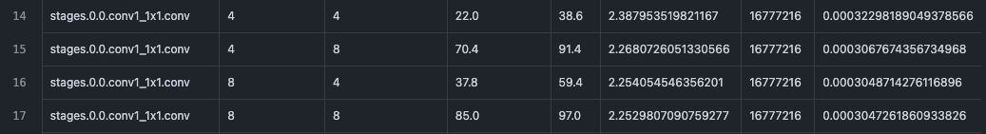
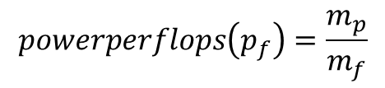



Sensitivity Analysis
Pretrained model: mobileViT_s
Bit-widths: 4/8
Accuracy: Top-1 & Top-5
Analysis method: Layer by layer
Quantization: Uniform quantization
Calibration: Min-max
Hardware: RTX 3080 GPU
Esteemed energy calculation
$$MaxPower\left(m_{p}\right)=240W$$
$$Maxflops\left(m_{f}\right)=28.77e12$$
$$powerperflops\left(p_{f}\right)=\frac{m_{p}}{m_{f}}$$
Output
$$Energy(l)=pf∗latency$$
Notes:
Currently, we used mobilevit_s model and bit-widths only used 4 and 8. However, our current implementation code can take any bit-widths for this analysis with simple change. Describe the other things.
Click
For the hardware, we currently used 3080 GPU from Nvidia to esteemed energy. We can get the maximum energy consumed after applying quantization on the layer. Usually power in a gpu in total is summation of base power, memory, and flops. We omitted 80W as it used for memory which is 240 W and maximum flops for this gpu is 28.77e12. dividing max power over max flops will give us the power perflops. Which later used to calculate the energy we can see the equation. There is the sample output of the sensitive analysis.

Slide 11
Time line
Decide the topic.
Stage1: Determine the search framework.
Stage2: Complete the sensitivity analysis for each layer.
Stage3: Build the search engine / search algorithm.
Stage4: Test the search framework by using MobileViT and add other edge device.
Document and publish the paper hopefully!!!
Notes:
This is the rough timeline. We accomplish until stage 2 and now working on stage 3 to develop the search engine.

Slide 12
Conclusion
We aim to design a hardware-efficient post training quantization policy for hybrid model.
The detailed layer by layer sensitivity analysis after applying uniform quantization to find the optimal quantization policy within a budget.
We will focus to design the search algorithm (evolutionary search) from this lookup table of sensitive analysis.
Notes:
Here is the conclusion, we aim to propose a hardware efficient quantization policy for hybrid model.The detailed layer by layer sensitive analysis we conduct is one of the important thing in our proposed framwork. We will focus to design the search space to find the suboptimal quantization policy with real hardware deployment.

Slide 13
Reference
Mehta, Sachin, and Mohammad Rastegari. "Mobilevit: light-weight, general-purpose, and mobile-friendly vision transformer." arXiv preprint arXiv:2110.02178 (2021).
Carion, Nicolas, et al. "End-to-end object detection with transformers." European conference on computer vision. Cham: Springer International Publishing, 2020.
Wu, D., Tang, Q., Zhao, Y., Zhang, M., Fu, Y., & Zhang, D. (2020). EasyQuant: Post-training Quantization via Scale Optimization. arXiv preprint arXiv:2006.16669.
Yunqing Zhao, et al. "Post-Training Quantization for Vision Transformers with Twin Uniform Quantization." arXiv preprint arXiv:2111.12293 (2021).
Kim, Nam Joon, Jongho Lee, and Hyun Kim. "HyQ: Hardware-Friendly Post-Training Quantization for CNN-Transformer Hybrid Networks." IJCAI. 2024.
Wang, Kuan, et al. "Haq: Hardware-aware automated quantization with mixed precision." Proceedings of the IEEE/CVF conference on computer vision and pattern recognition. 2019.
Notes:
Those are some references in this slides.

Slide 14
Thank you
Notes:
If any question, you can ask, Thank you for listening.

